Slide 1







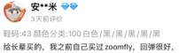







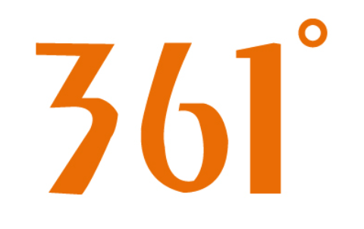
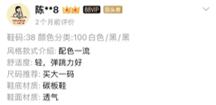










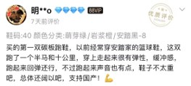
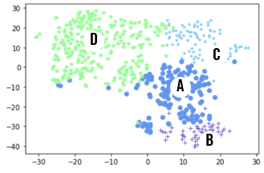

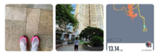
PRODUCT CLUSTERING METHODOLOGY
WEB-SCRAPPING
EXTRACT DATA
NATURAL LANGUAGE PROCESSING
FEATURE ENGINEERING
PRODUCT CLUSTERING
ALGORITHMETIC INTERPRETATION
BASED ON FEATURES FROM THE CONSUMER REVIEWS
25
FLAGSHIP
STORES
PROFILE
Softness
Co-Brand
FUNCTIONALITY
Lightness
Celebrities
Brand Recognition
Breathability
FEMALE
COMFORT
IDENTIFICATION
Cost Effectiveness
Color
PRICE
DESIGN
Graphic
DESIGN
Comments
OCCASION
Cushion
360 Labels
Shape
COMFORT
Rebound
FUNCTIONALITY
Running
800+
TOP STYLES
Top 50 SKUs
&
Comments >50
Top 30 SKUs
&
Comments >50
Containment
Walking
Lightweight
Training
Support
Stability
…Other Sports
Mix & Match
OCCASION
IDENTIFICATION
GROUP THE PRODUCTS ACCORDING TO FEATURE SIMILARITY
911K
REVIEWS

Slide 2
Roadmap
评论数据采集
数据质量验证
评论情感分析
评论聚类
生成标签--语料库
给原始评论打标签
聚类清理
数据清洗
聚类主题提炼
特殊类关键词提取

Slide 3
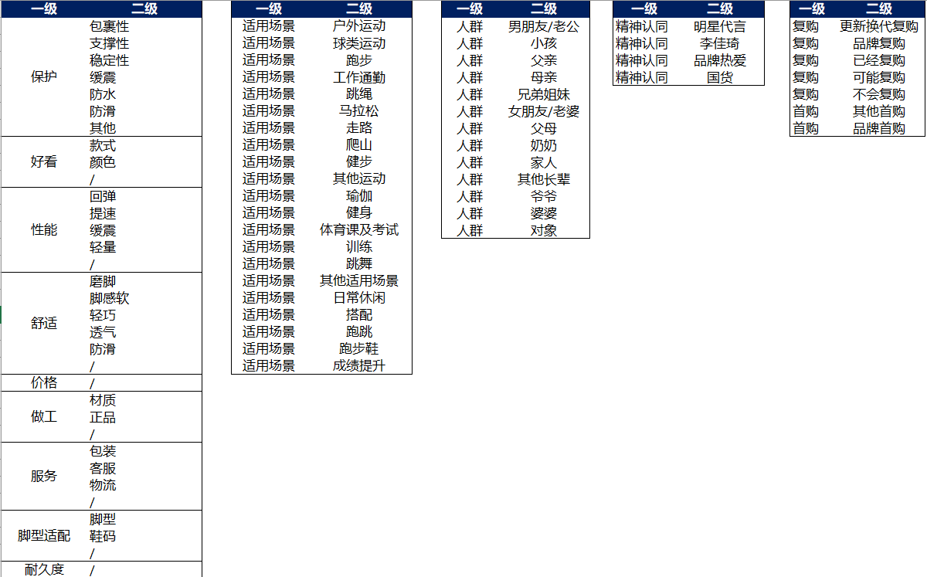

Slide 4

Data Cleaning
优点：1.颜值-耐克家鞋子颜值一如既往的好看，属于跑鞋品牌里的颜值一线。2.科技-这双搭载了全掌碳板，据说推力不错具体跑步效果还要上脚跑一下再评论。鞋面材质比较轻薄，透气性不错。大底才用的是React材质，上脚弹性不错虽然不及ZoomX重量也略重但胜在耐用。3.脚感-上脚走了几步，有一点踩高跷的感觉。这双4cm大厚底本来就高而且后掌设计又非常窄，所以走路的话会感觉有点晃稳定性不够。感觉这双适合中掌或者前掌着地的跑者，后跟跑法除非退步力量和脚踝力量比较强壮的还行，如果大是体重初跑者容易感觉会增加受伤风险。 缺点：1.当竞速鞋穿吧重量有点重，当训练鞋穿吧又有碳板，定位有点尴尬。 总结：初步感觉是一双不错的中端竞速跑鞋，重量稍重，缓震出色，适合有一定跑步基础的跑者。具体感受跑一段时间再追评。
原始评论断句
标点符号
转折语(但是、不过、而且）
1…2…3…4…
句子去叠字、繁体字等操作
Be️🔻走起路来很轻快，抓地效🍑果非常好，非常🏕透气，不臭脚！大小🍾🍾正好，外观颜值非️常高。气垫有弹性，非常🗳🗳适合慢跑，有减震的💫效果，除了冬季其他季节穿都很合适。面料️手感柔软细腻，胶粘合度🍮完美，穿的不顶脚。一体化流线型设计，耐克的🏸鞋子非常超值

Slide 5
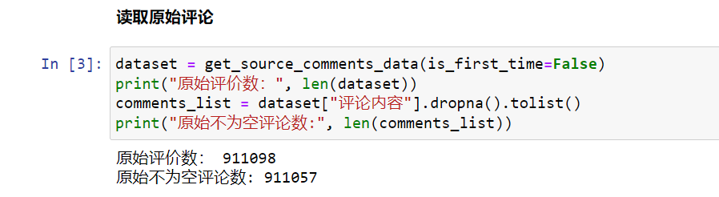
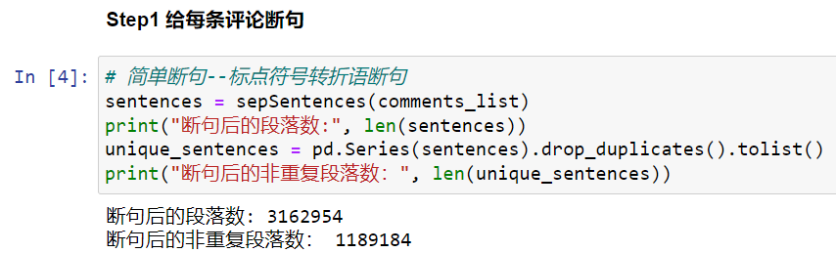
代码说明
原始数据：folder---跑鞋评论数据更新1119
代码文件：Step1GetSentiment

Slide 6
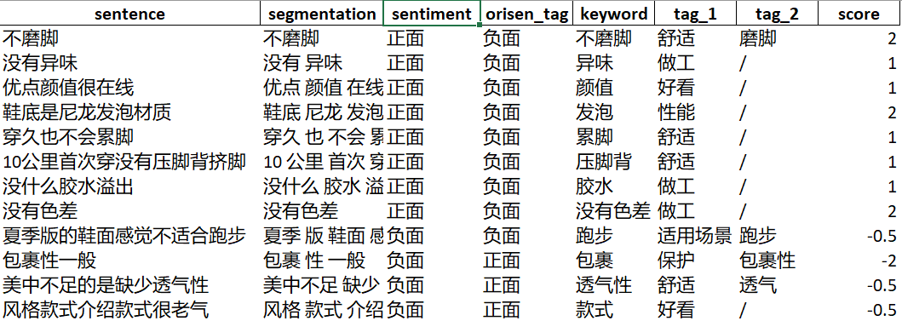
Sentiment Analysis
Snownlp情感分数，划分positive, negative, neutral
利用我们的关键词表keywords_sentimental_words.xlsx设计算法改进snownlp的情感分析结果---如果一句话里有我们自定义的关键词，那么这句话会被我们的算法重新计算情感；如果没有我们自定义的关键词,那么情感按照snownlp的结果来
算法逻辑主要是关键词（有自身正负分数）* 关键词前后的情感词汇的分数
遗留的问题/优化方向：
1. 情感分析还在继续优化，还有很多类里面的正负情感混杂

Slide 7
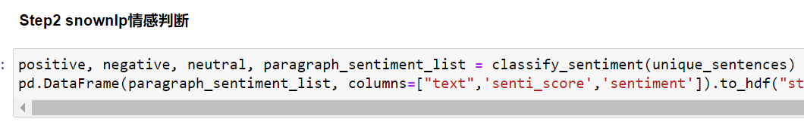
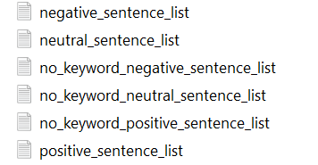
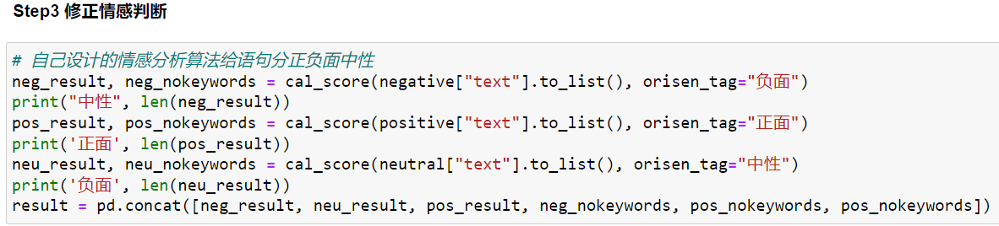
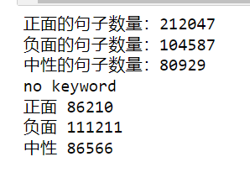
代码说明
关键词及情感词文件：\\shanghai-nas-01\SP.and.A_MI\9.Data Exchange\Ruofei\2022\running_ftw_reviews\model_input\keywords
代码文件：Step1GetSentiment
结果文件：\\shanghai-nas-01\SP.and.A_MI\9.Data Exchange\Ruofei\2022\running_ftw_reviews\model_result\sentiment
生成的结果

Slide 8
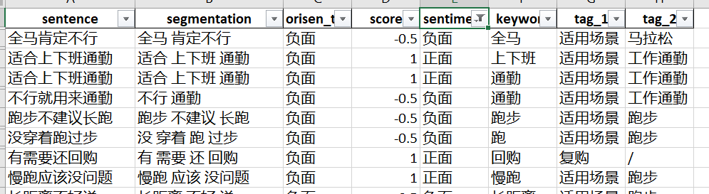
关于场景、人群、首购复购、精神认同的说明
最先是根据step2聚类后收集的这些话题的类；
最新版把这些主题写进了关键词，所以在第一步根据关键词打标的时候，就会直接把这些话题的内容先筛选出来

Slide 9
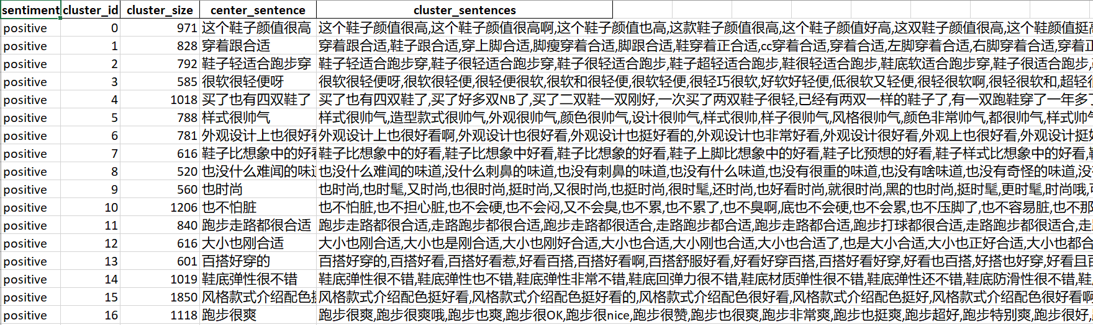
Clustering
Bert模型给句子向量化
用余弦相似度给句子聚类，并且给出类的中心语句
每个类里的句子按照离中心语句的远近排序
优化方向
如何提高类的准确性（离中心语句意思较远的句子如何自动扔掉避免人工）
用分类模型替换聚类（维度-情感作为标签）

Slide 10
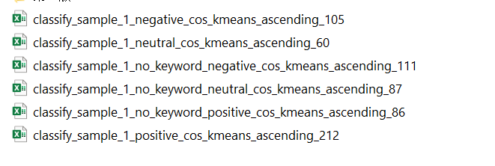
代码说明
代码文件：Step2Clustering
结果文件：\\shanghai-nas-01\SP.and.A_MI\9.Data Exchange\Ruofei\2022\running_ftw_reviews\model_result\cluster

Slide 11
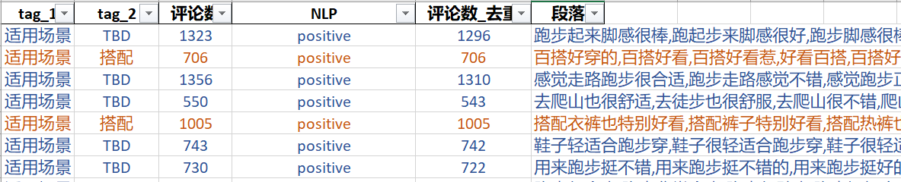
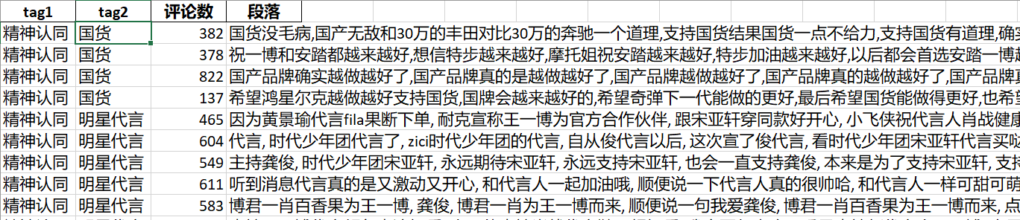
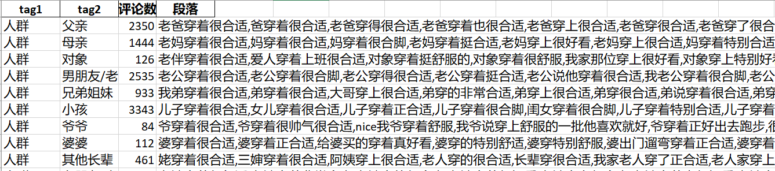
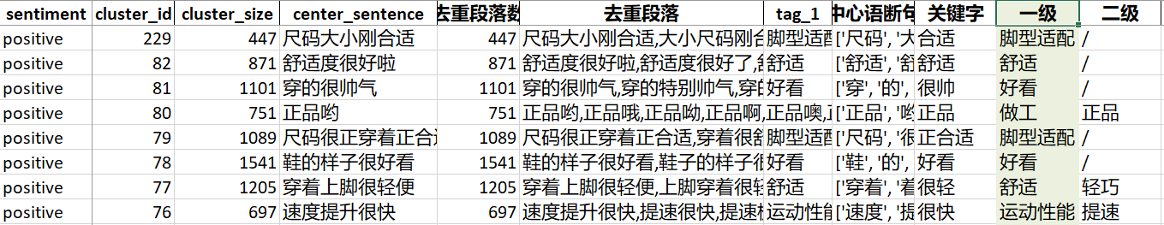
Clustering-continue…
手工挑出来人群，场景，首购复购，精神认同类、进一步提炼关键词，打二级标签
合并其他聚类并按照中心语句的关键词机打一级、二级标签
人工审核每个类的质量和一级二级标签，给每个类下一步处理方案打标签
用机器进一步清理优化每个类
优化方向
1. 人工的时间太多，还能有哪些地方可以用机器降低人工成本

Slide 12
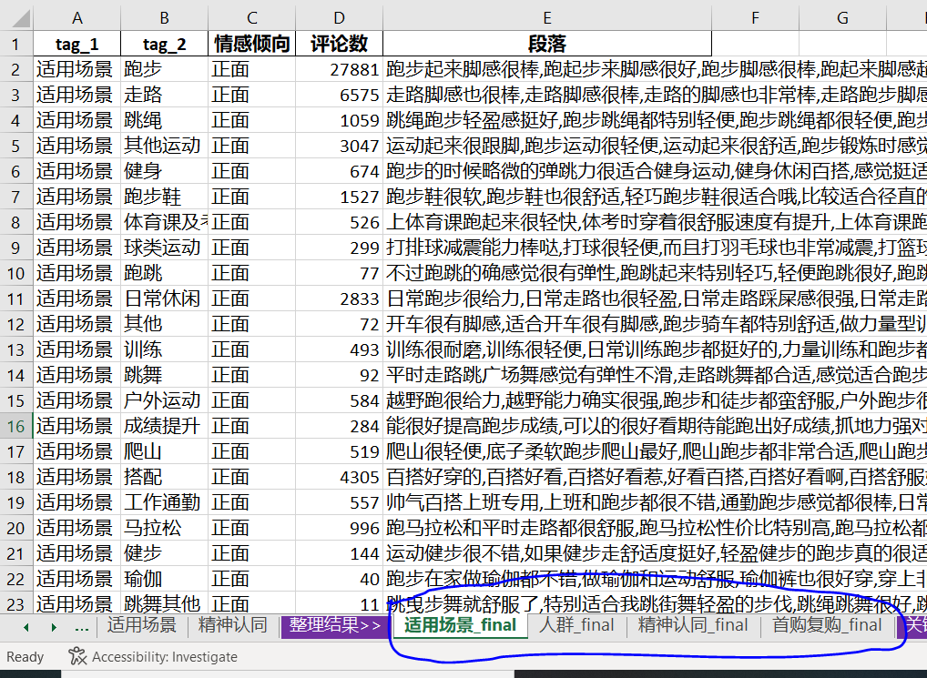
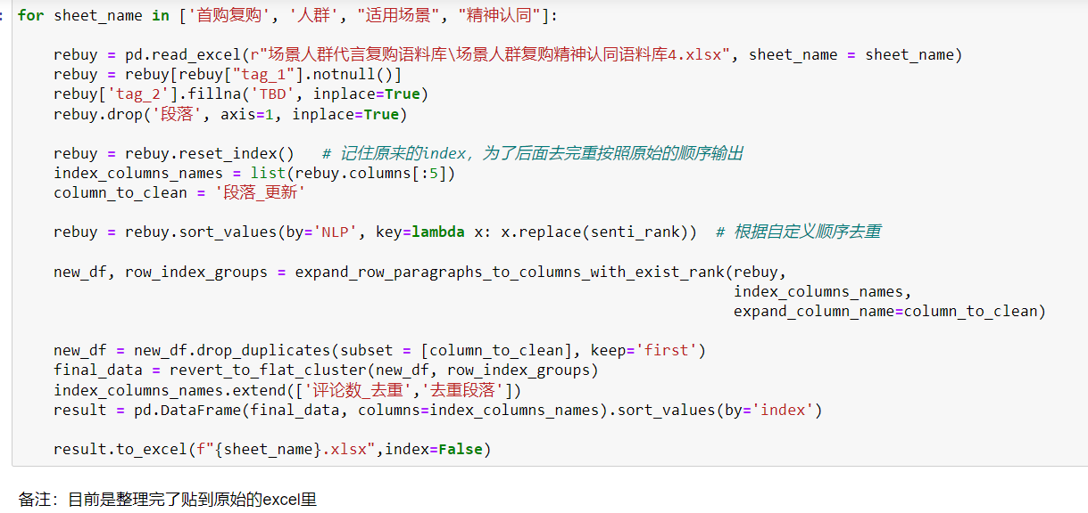
代码说明
代码文件：Part3CorpusTools
整理后的人群，场景，首购复购，精神认同类文件： \\shanghai-nas-01\SP.and.A_MI\9.Data Exchange\Ruofei\2022\running_ftw_reviews\场景人群代言复购语料库
整理后的全部聚类结果： \\shanghai-nas-01\SP.and.A_MI\9.Data Exchange\Ruofei\2022\running_ftw_reviews\step_data\ cluster_result_combine_all_sentiments_no_dup_tag4.xlsx
（这个文件是需要进一步手工整理的，确认每个类有什么问题，通过数字打标标注每个类还需要清理的问题）

Slide 13
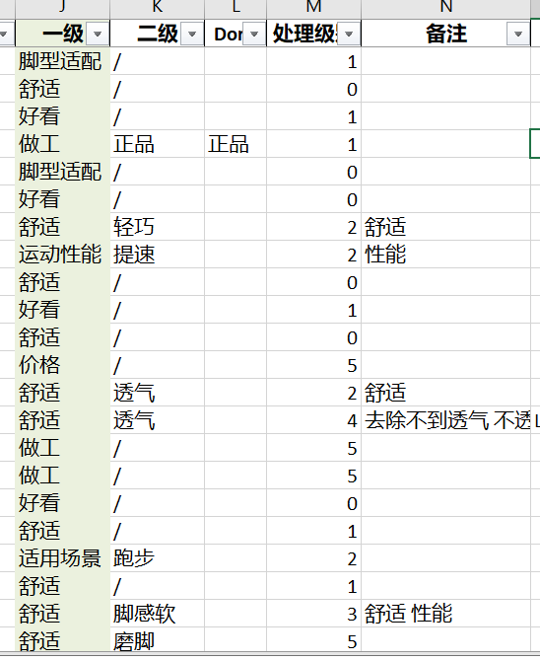
人工整理类的问题-续
cluster_result_combine_all_sentiments_no_dup_tag4.xlsx
人工检查和修改的字段主要是一级、二级、处理级别和备注
处理级别
0：没问题
1：人工删掉了尾巴不相干的句子
2：一级分类内部需要精调整
3：段落里有多种一级分类
4：去除、保留含有指定词的句子，格式是去除/保留+由空格拼接的词；
补充其他的一级分类（很轻也很好看->补充好看），格式是补充+空格拼接的一级分类名
5：删除该聚类
有一个代码文件叫cluster_tag_12345 是Doris写的自动打处理级别那一列的代码，质量还可以，可以先跑这个再人眼整理这几列，更高效

Slide 14
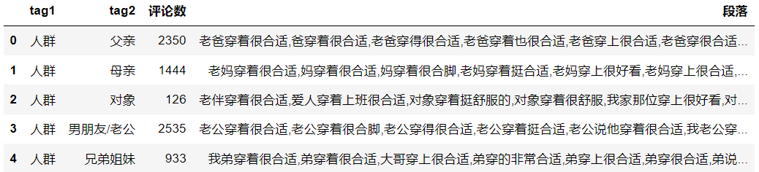
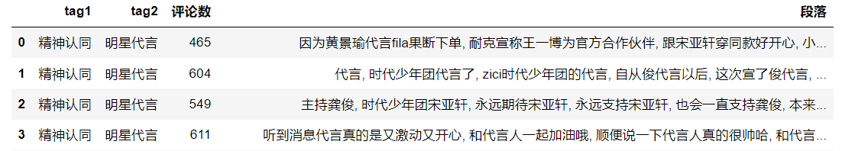
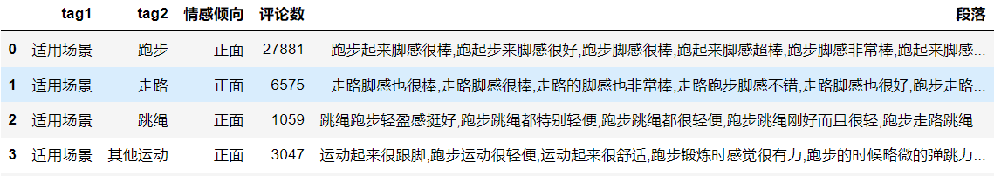
代码说明-续
代码文件：Part4CleanSpecialClusters
输入数据：r'model_input\keywords\keywords_sentimental_words.xlsx'
r'场景人群代言复购语料库/场景人群复购精神认同语料库4.xlsx’
代码功能：给一级标签是场景、人群、精神认同、首购复购的段落打上二级标签

Slide 15
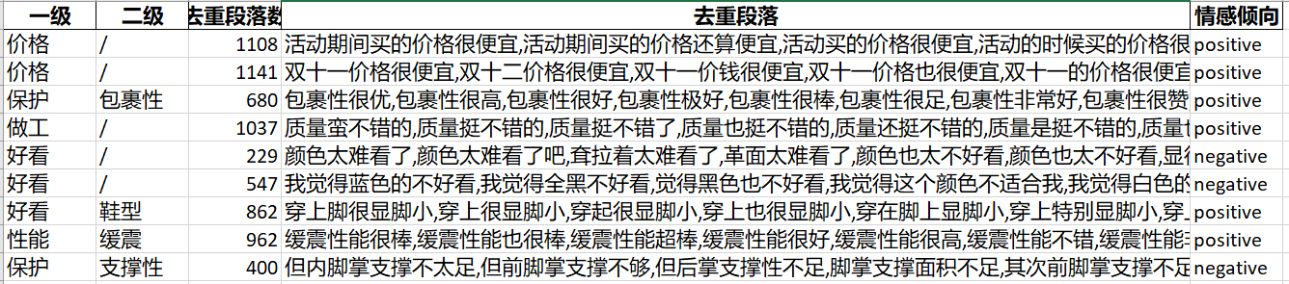
代码说明-续
代码文件：Part4CleanNormalClusters
输入数据：r'model_input\keywords\keywords_sentimental_words.xlsx'
step_data/cluster_result_combine_all_sentiments_no_dup_tag4.xlsx
输出数据：model_result/语料库/corpus_final.xlsx （最后整理好的语料库）
代码功能：根据处理级别和备注，把类的内容做进一步清洗

Slide 16
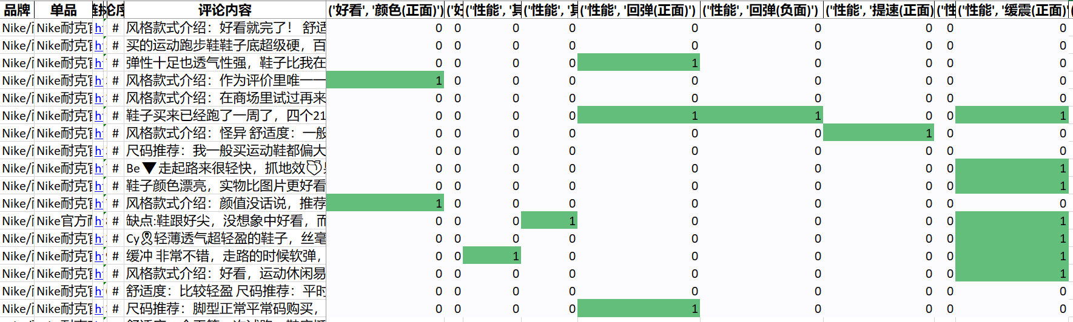
Tag Comments

Slide 17
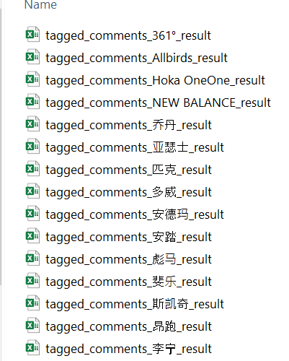
代码说明
代码文件：Step5.tag_comments
输入数据：‘step_data/comments_dataset.h5’ （原始评论数据）
输出数据：\\shanghai-nas-01\SP.and.A_MI\9.Data Exchange\Ruofei\2022\running_ftw_reviews\model_result\评论标签结果
代码功能：根据整理好的语料库给每条评论打标签

Slide 18


PRODUCT VIRTURAL PERSONA BY DIFFERENT CLUSTERS
CONSIDERATION FACTOR¹
USAGE SCENARIO
PROFILE
PRODUCT CLUSTERING
DESIGN
FUNCTION-ALITY
PRICE
RUNNING²
SPORTS RICHNESS³
NON SPORTS²
WOMENS %
GIFT FOR OTHERS⁴
PROFESSIONALITY
DEDICATE RUNNING
A
23%
25%
8%
70%
3%
22%
8%
FUNCTIONALITY + LIFE CONCEPT
B
32%
20%
6%
50%
11%
33%
5%
SPORTS²
DAD & MOM
C
25%
12%
11%
48%
7%
29%
10%
MIX & MATCH
DARLING
EXTENSION OF USAGE
D
35%
9%
10%
26%
23%
36%
11%
1.DESIGN, FUNCTIONALITY AND PRICE: KEY WORDS FREQUENCY / COMMENTS #
2.RUNNING, NON SPORTS: KEY WORDS FREQUENCY / OCCASION-RELATED COMMENTS #
3.SPORTS RICHNESS: ENTROPY OF OCCASIONS
4.GIFT FOR OTHERS: GIFT FOR OTHERS FREQUENCY / COMMENTS #
Notes:
#口径标注
1. DESIGN，COMFORT，FUNCTIONALITY，PRICE：分子为相应标签数，分母为总评论数，by sku平均；
2. USAGE SCENARIO，前两项分子为相应标签数，分母为场景评论数；最后一项为信息熵*100。 By sku平均
3. 人群结构： 分子为相应项目，分母为人群评论数，by 总评论平均
可能被cue:
Considerationn factor加起来不是100%的原因：有的评论同时提及了多项、二级标签多个1可以累加（比如design的鞋型和好看如果在同一条评论中被提到则“设计”变为2）
为什么分母不同：emmmm
熵的含义：复杂度/不确定性/丰富度 公式 :ent = -plogp
versatility

Slide 19













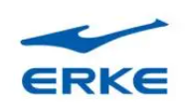
PRODUCT CLUSTERING SUMMARY
SOB %
3YR CAGR
NIKE IS
SOB %
3YR CAGR
NIKE IS
16%
8%
A
DEDICATE RUNNING
B
FUNCTIONALITY + LIFE CONCEPT
2%
44%
PURCHASE CRITERIA: FUNCTIONALITY NO.1
USAGE SCENARIO: RUNNING
CORE MSRP RANGE:
DOMESTIC BRANDS: RMB 300-500
INTERNATIONAL BRAND RMB 600+
TOP BRANDS:
PURCHASE CRITERIA: FUNCTIONALITY & DESIGN BOTH COUNT
USAGE SCENARIO: RUNNING + OTHERS
CORE MSRP RANGE: RMB 1000-1500
TOP BRANDS:
SOB %
3YR CAGR
SOB %
3YR CAGR
NIKE IS
42%
13%
MIX & MATCH
D
C
EXTENSIVE SPORTS
40%
-6%
PURCHASE CRITERIA: DESIGN > FUNCTIONALITY
USAGE SCENARIO: ALL KINDS OF SPORTS IN 1
CORE MSRP RANGE: RMB 200-600
TOP BRANDS
PURCHASE CRITERIA: DESIGN IS THE MOST CRITICAL
USAGE SCENARIO: DAILY COMMUTE, MIX & MATCH, LIGHT SPORTS
CORE MSRP RANGE:
DOMESTIC BRANDS: RMB 200-400
INTERNATIONAL BRANDS: RMB 500-700
TOP BRANDS:
Notes:
SOB & CAGR：total market, 6&11 excluded = +4%
A：绿灯/Functionality>Design>Price>Identification / Running is the main usage. / (Asics NIKE) （LINING QIAODAN XTEP）
B：红灯/Identification>Functionality>Design>Price/ To show uniqueness from others. / （ON SALOMON HOKA） （Adidas LINING ANTA NIKE(7)）
C：黄灯/Design>Functionality>Price>Identification / Sports footwear for multiple exercises. / (ADIDAS ANTA ) (PEAK NIKE ASICS XTEP LINING)
D：- /Design>Price>Functionality>Identification / Daily sneakers providing wild match with clothing. / (ANTA LINING ERKE) (SKECHERS) (361 NB XTEP) NIKE(9)
top brands: 按照排名排序，不展示具体brand的SOB

Slide 20
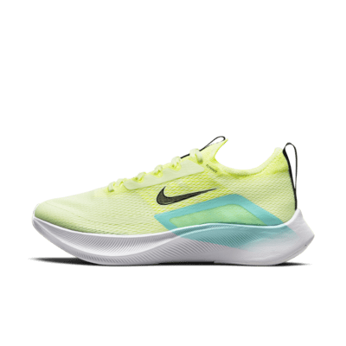
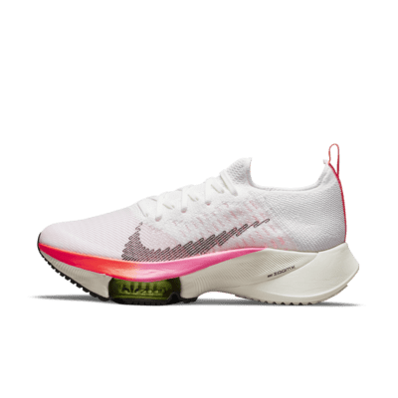
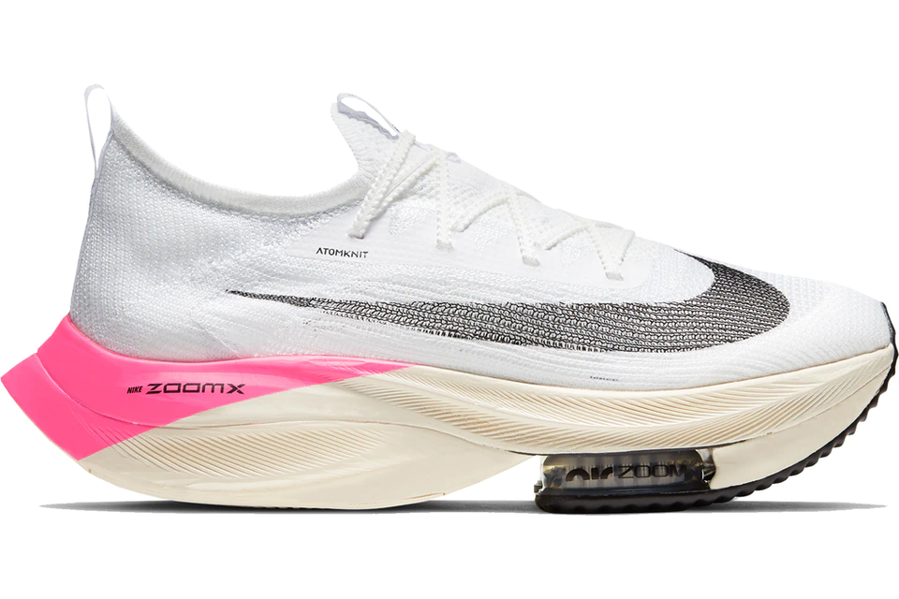
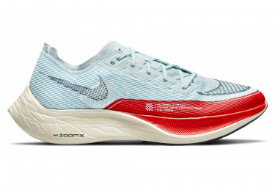
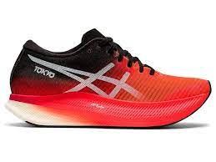
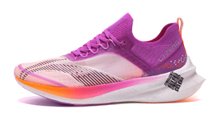
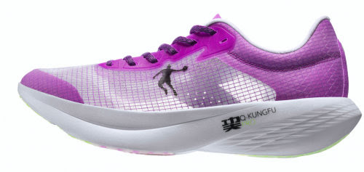
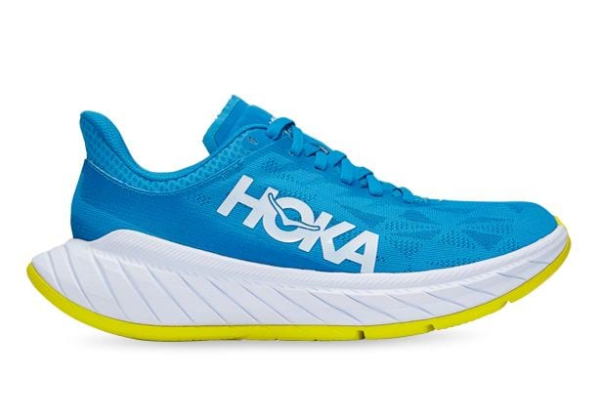
WE ARE WELL RECOGNIZED IN PROVIDING SUPREME FUNCTIONALITY (1/2)
@alex, 列举几个核心价位带产品，对比FUNCTIONALITY为主
可以竞速 zoom fly 和tempo没有区分度可以在那一页提到，越野，训练，各一张
>>产品力上没有问题
A
RACING
TEMPO TRAINING
PRODUCT
PORTFOLIO
KEYWORDS
Alphafly Next%
Vaporfly Next%
Metaspeed Sky
飞电 2.0 Elite
飞影 PB
Zoom Fly
Tempo Next%
Carbon X
MSRP
2,299
1,599
1,690
2,099
799
1,169
1,399
1,699
MONTHLY SALES¹
619
665
80
54
3,288
2,157
914
83
FUNCTI-ONALITY²
提速
SPEED
⭐⭐⭐⭐⭐
⭐⭐⭐⭐⭐
⭐⭐⭐⭐⭐
⭐⭐⭐⭐
⭐⭐⭐
⭐⭐⭐⭐
⭐⭐⭐⭐
⭐⭐⭐
舒适
COMFORT
⭐⭐⭐⭐⭐
⭐⭐⭐⭐⭐
⭐⭐⭐⭐
⭐⭐⭐⭐
⭐⭐⭐⭐
⭐⭐⭐
⭐⭐⭐⭐
⭐⭐
保护
PROTECT
⭐⭐⭐⭐
⭐⭐⭐
⭐⭐
⭐⭐⭐
⭐⭐
⭐⭐
⭐⭐
⭐⭐⭐
耐用性
DURABILITY
⭐⭐⭐
⭐⭐⭐
⭐⭐
⭐⭐⭐⭐
⭐⭐⭐
⭐⭐⭐⭐
⭐⭐⭐
⭐⭐
多功能 MULTI FUNCTIOAL
⭐⭐
⭐⭐
⭐
⭐⭐
⭐
⭐⭐
⭐⭐
⭐⭐
VOICE OF CONSUMER
PROS
Exist to break the record
Need to run faster to be worthy of the shoe
Suring propulsive force
Suitable for more runners
Excellent breathability
Great durability and price value
Some runners even scratched out the logo to wear it in marathon
First class lockdown on upper
Great cushioning and springiness
Good stability
Design is highly recognizable
Extreme springback
Strong springiness
First class outsole
Excellent cushioning
Great looks
CONS
Not suitable for wide feet
The only cons is the price
Bad stability makes it too difficult to control
Outsole not wear-resistant
Lack of stability on heels
Totally overprice
Uncomfortable upper
Lack of support
Not light in weight
Stability less than satisfactory
Designed for elite runners’ training but does not feel like Alphafly or Vaporfly.
Not as light as Peg turbo. Zoom fly with better price value
Outsole not wear-resistant
Not light in weight
Lack of lockdown on heels
MONTHLY SALES: MONTHLY SALES QTY OF THE MODEL ON TMALL EXCLUDING RETAIL MOMENTS D11 AND 618
FUNCTIONALITY: REVIEW BASED ON LATEST VERSION OF EACH MODEL

Slide 21
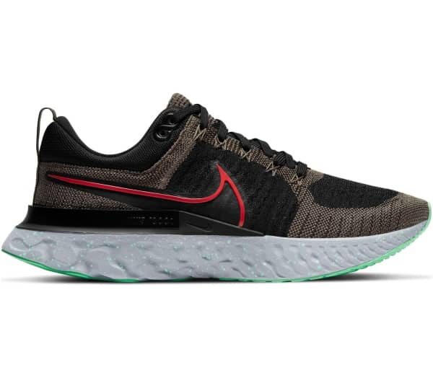
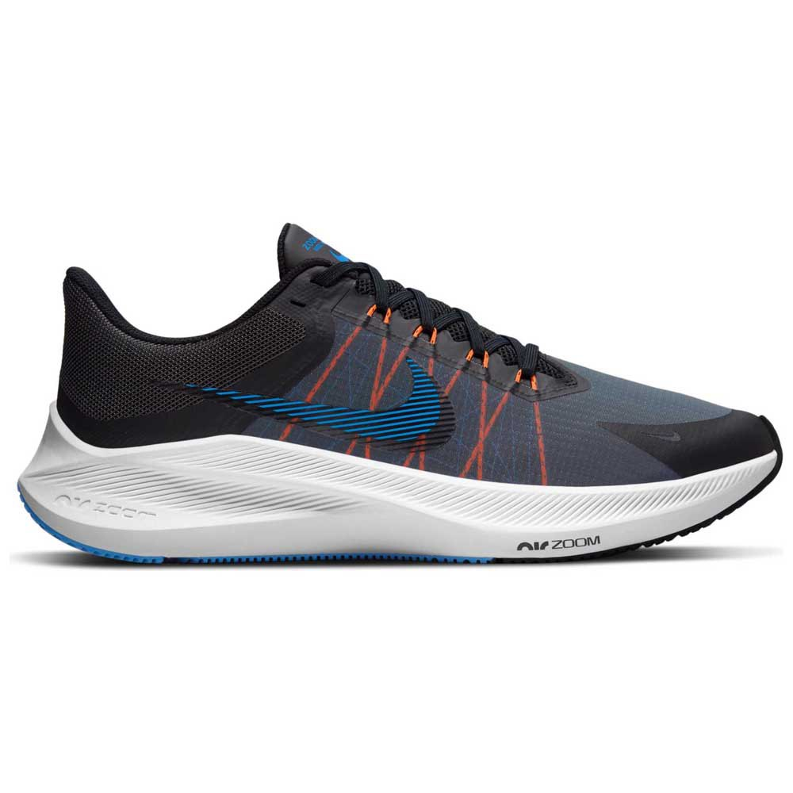
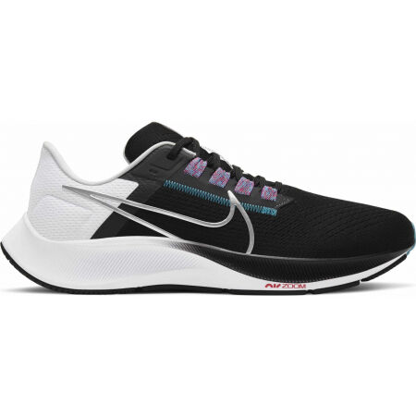
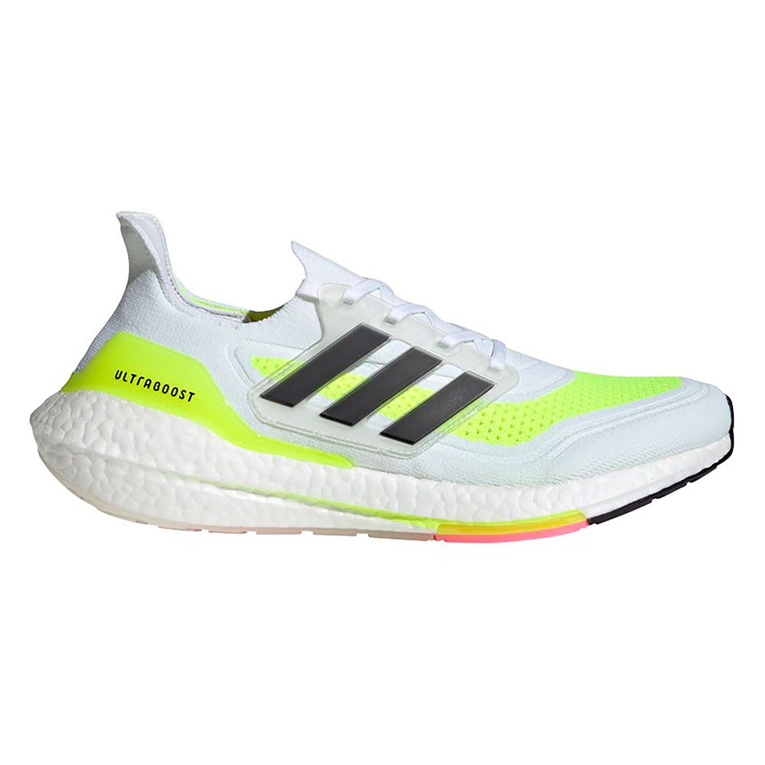
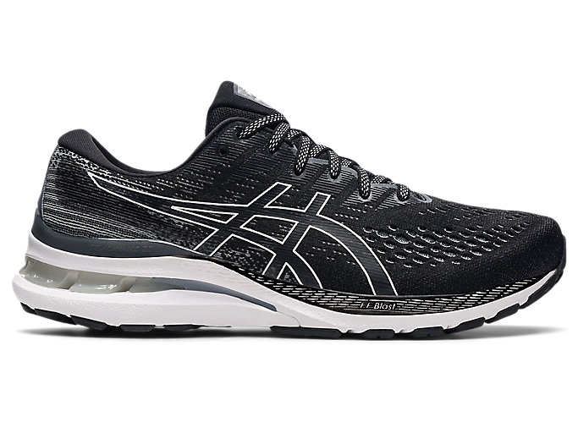
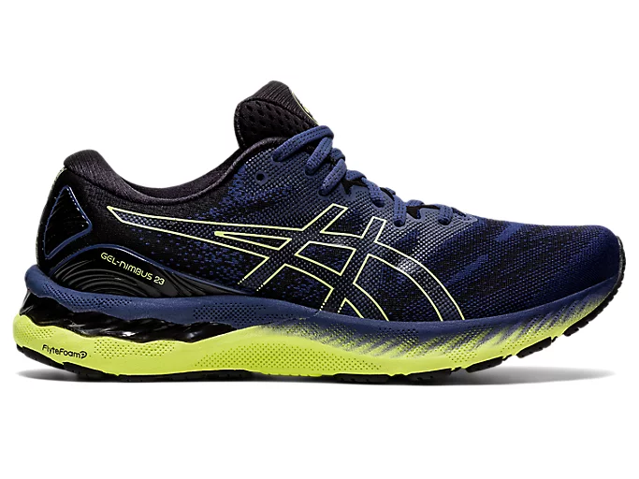
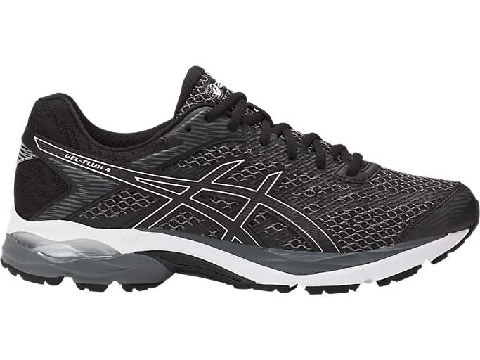
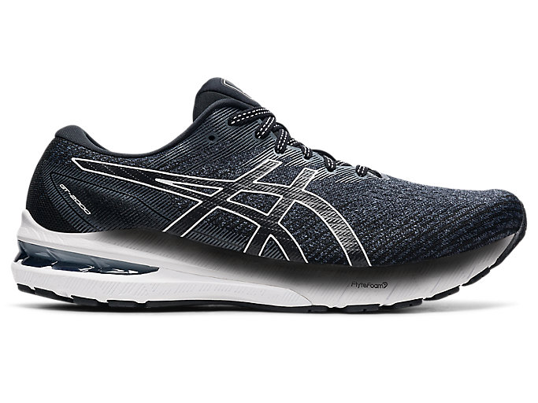
WE ARE WELL RECOGNIZED IN PROVIDING SUPREME FUNCTIONALITY (2/2)
@alex, 列举几个核心价位带产品，对比FUNCTIONALITY为主
可以竞速 zoom fly 和tempo没有区分度可以在那一页提到，越野，训练，各一张
>>产品力上没有问题
A
JOGGING
RMB<1000
RMB>1000
PRODUCT
PORTFOLIO
KEYWORDS
Ultraboost
Kayano
Nimbus
React Infinity Run
Gel-Flux
Winflo
Pegasus
GT 2000 10
MSRP
1,499
1,390
1,290
1,299
690
749
899
890
MONTHLY SALES¹
11,692
2,303
2,031
782
9,210
8,291
3,796
2,503
FUNCTI-ONALITY²
提速
SPEED
⭐⭐
⭐⭐
⭐⭐
⭐⭐⭐
⭐⭐
⭐
⭐⭐⭐
⭐⭐⭐
舒适
COMFORT
⭐⭐⭐⭐
⭐⭐
⭐⭐⭐⭐
⭐⭐⭐⭐
⭐⭐⭐
⭐⭐⭐
⭐⭐⭐
⭐⭐
保护
PROTECT
⭐
⭐⭐⭐⭐
⭐⭐⭐
⭐⭐⭐
⭐⭐
⭐⭐
⭐⭐
⭐⭐⭐
耐用性
DURABILITY
⭐⭐
⭐⭐⭐⭐
⭐⭐⭐⭐
⭐⭐⭐⭐
⭐⭐⭐
⭐⭐
⭐⭐⭐
⭐⭐⭐
多功能 MULTI FUNCTIOAL
⭐
⭐⭐
⭐⭐
⭐
⭐⭐
⭐⭐
⭐⭐⭐
⭐⭐
VOICE OF CONSUMER
PROS
Top-level upper support and outsole wear-resistance
Friendly to new runners
Top-level cushioning
Very soft and agile, with strong anti-torsion
Excellent lockdown on heels
Great support and stability thanks to the upgraded upper
Fascinating feet feel & sufficient cushioning
Great shoe for new runners
Looks is easy to style
Midsole is soft, feel like stepping on cotton
The best running shoes for every runner
Well-balanced functionalities
Great shoe for light weight runners with balanced performance
Outsole technology is worthy of its reputation
Looks really cool
Great cushioning
CONS
Midsole springiness decays quickly, not suitable for long distance run
Upper too tight and the weight is heavy
New Upper does not look good
Heavier weight make it not suitable for speed run
Poor quality
Hard outsole
Lack of lockdown on heels
Poor breathability
Poor breathability
Insufficient stability
Upper not durable
MONTHLY SALES: MONTHLY SALES QTY OF THE MODEL ON TMALL EXCLUDING RETAIL MOMENTS D11 AND 618
FUNCTIONALITY: REVIEW BASED ON LATEST VERSION OF EACH MODEL

Slide 22

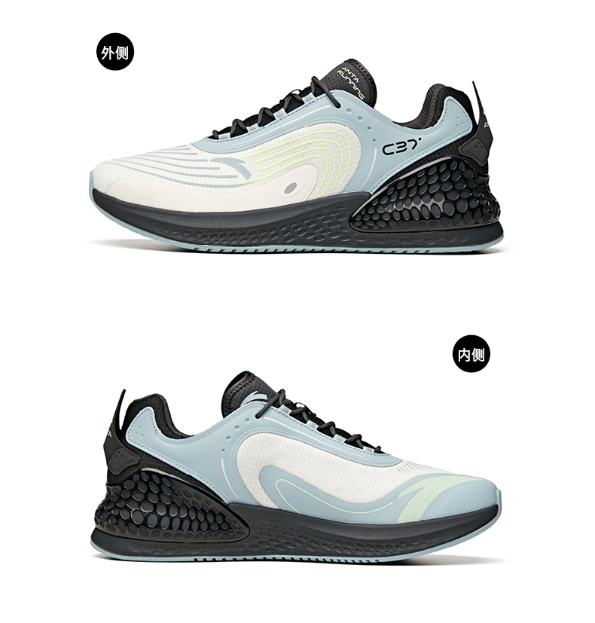
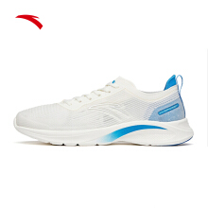
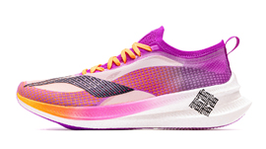




LOCAL COMPETITORS MET WITH LIMITED SUCCESS IN RACING / TEMPO TRAINING BUT STILL WITH GAPS IN SERVING MASS RUNNERS
@alex, 列举几个核心价位带产品，对比FUNCTIONALITY为主
可以竞速 zoom fly 和tempo没有区分度可以在那一页提到，越野，训练，各一张
>>产品力上没有问题
A
LOCAL COMPETITORS’
PRODUCT
Significant Upgrade For This Generation
RACING/TEMPO RUNNING
JOGGING
PORTFOLIO
KEYWORDS
飞影 PB
绝影
160X PRO
C202 GT
C37+
氢科技跑鞋
超轻
赤兔5 PRO
飞电 2.0 Elite
MSRP
799
1,799
1,199
999
449
399
599
539
2,099
MONTHLY SALES¹
3,288
498
298
265
24,388
9,844
5,521
215
54
FUNCTI-ONALITY²
提速
SPEED
⭐⭐⭐
⭐⭐⭐
⭐⭐⭐
⭐⭐
⭐
⭐⭐⭐
⭐⭐⭐
⭐⭐
⭐⭐⭐⭐
舒适
COMFORT
⭐⭐⭐⭐
⭐⭐
⭐⭐⭐
⭐
⭐⭐
⭐⭐
⭐
⭐⭐
⭐⭐⭐⭐
保护
PROTECT
⭐⭐
⭐⭐
⭐⭐⭐
⭐⭐
⭐
⭐
⭐⭐
⭐
⭐⭐⭐
耐用性
DURABILITY
⭐⭐⭐
⭐⭐
⭐⭐
⭐⭐
⭐⭐
⭐
⭐
⭐⭐
⭐⭐⭐⭐
多功能 MULTI FUNCTIOAL
⭐
⭐⭐
⭐⭐
⭐
⭐
⭐
⭐
-
⭐⭐
VOICE OF CONSUMER
PROS
Excellent breathability
Great durability and price value
Some runners even scratched out the logo to wear it in marathon
Design with strong visual impact
Renew my knowing of Lining thanks to XiaoZhan
Barely feel the weight
Looks great for styling
Strong propulsion
Great containment
Outsole is with good traction and durability
Midsole is soft
Light & breathable
Outsole is durable
Strong springiness
First class outsole
CONS
Poor breathability
Carbon was hard and hurt the arch
Shoe heels always drop during running
It’s an average racing shoe lack of highlights
Weight is heavy
Midsole responsiveness decays quickly
Upper with no containment or extension. It’s very uncomfortable
Midesole can’t even compare with Qiaodan
Running? You can hurt your ankle while walking in it
Is it false advertising to call it running shoe?
Poor stability and easy to get knees & ankles hurt
Cushioning way too soft, definitely not meant for running
Weight is like magnet as a professional running shoe
It’s like skating when running on wet roads
Lack of stability on heels
Totally overprice
Uncomfortable upper
Lack of support
MONTHLY SALES: MONTHLY SALES QTY OF THE MODEL ON TMALL EXCLUDING RETAIL MOMENTS D11 AND 618
FUNCTIONALITY: REVIEW BASED ON LATEST VERSION OF EACH MODEL

